Slide 1
Libertatem Healthcare
UX Vision

Slide 2
UX Vision
We have a chance to...
Improve the current application with a cleaner and simpler design.
Provide a more engaging user experience by understanding how people will be interacting with the site and helping them do that more efficiently.
Make improved input tools to get better information entered quicker and with fewer mistakes.

Slide 3
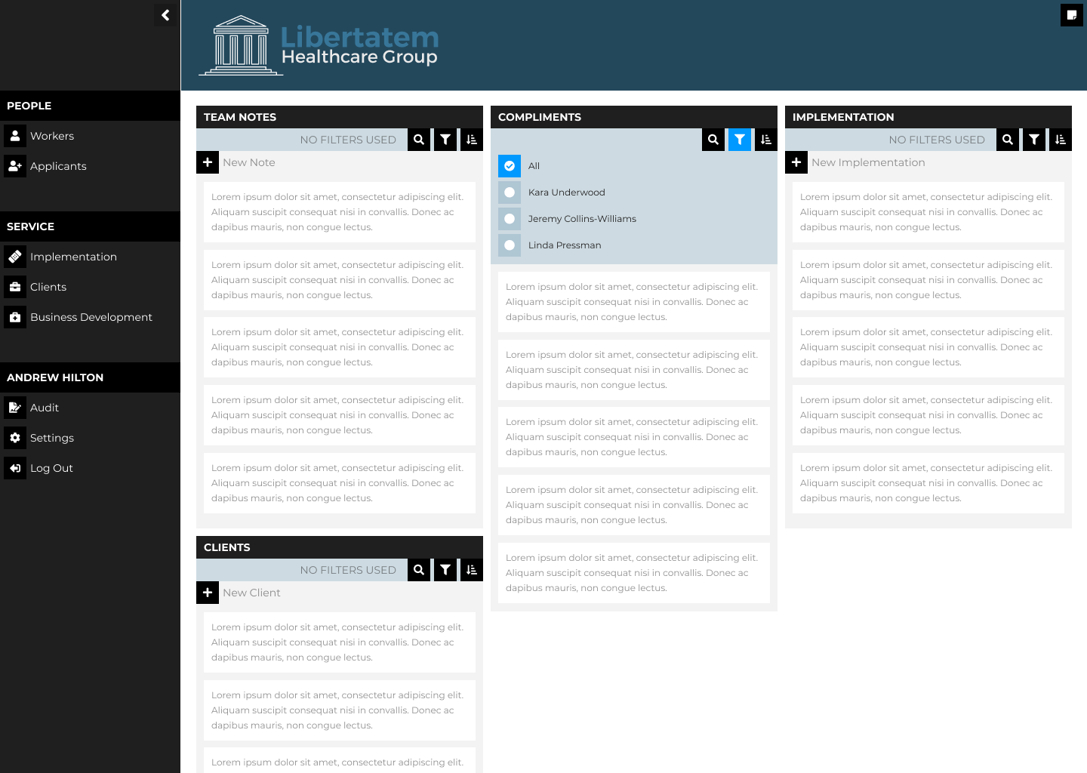
A New Look
We make the website cleaner & easier to reskin.
We focus on making putting tools where the user wants them when they want them, and hiding them away when they do not.
We group common actions. Everything on that Filter area is about changing the information in the block.

Slide 4
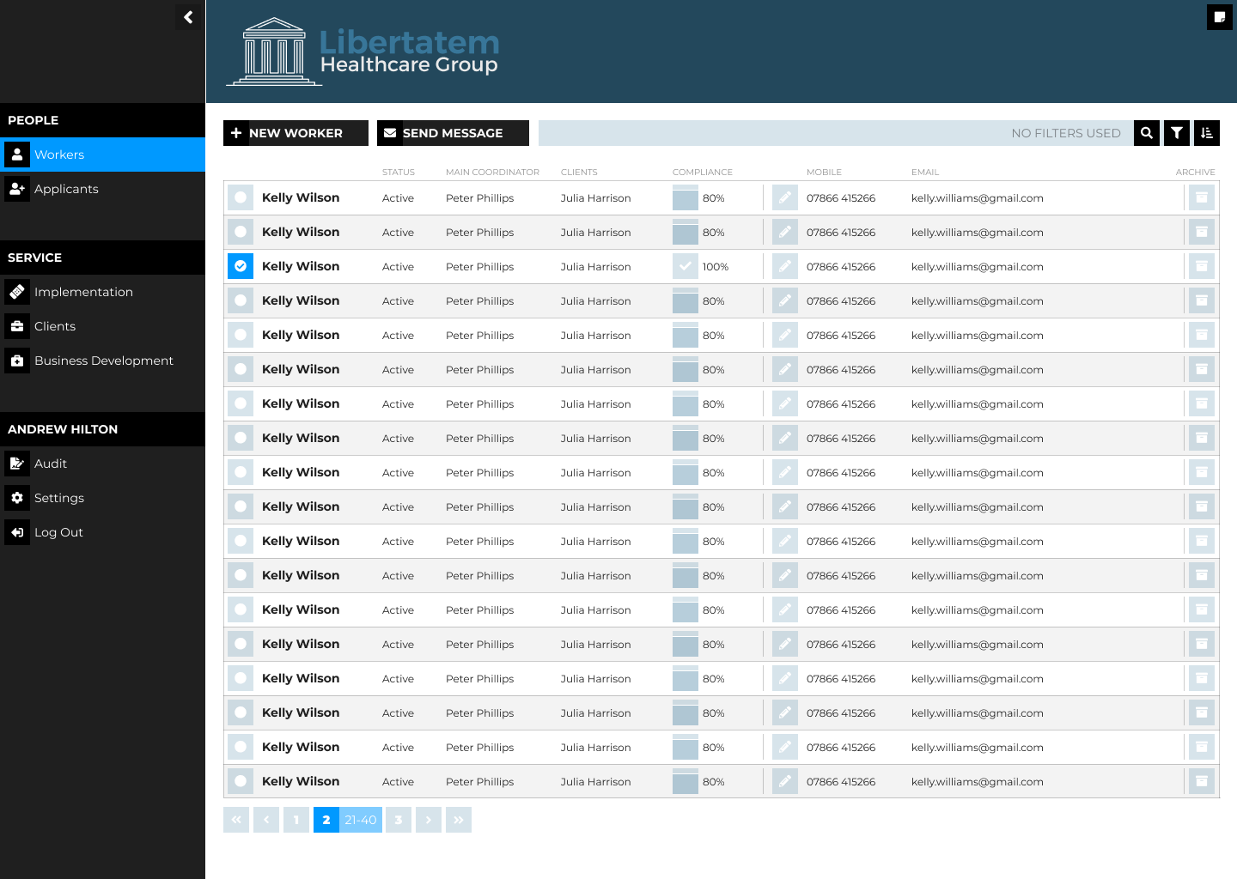
Going Deeper
These tools can be used on every page so that when a user knows how to do something on one page, they have learned how to do it on all the pages.

Slide 5
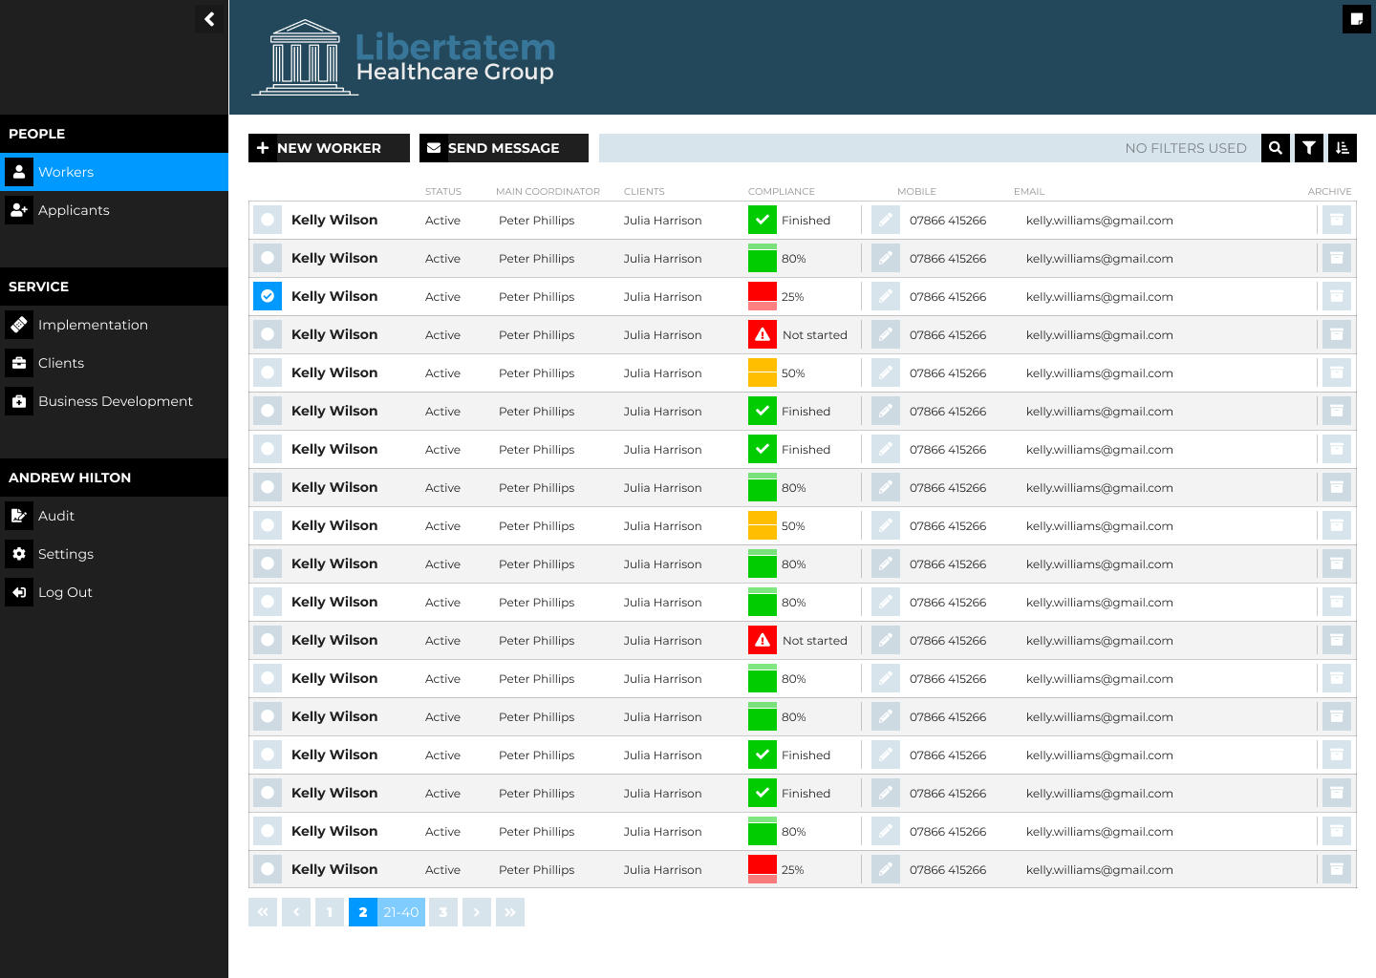
Colour Matters
Because we understand the data we can highlight what we want to.
For example we could use a Traffic Light system to show Compliance Completion levels.

Slide 6
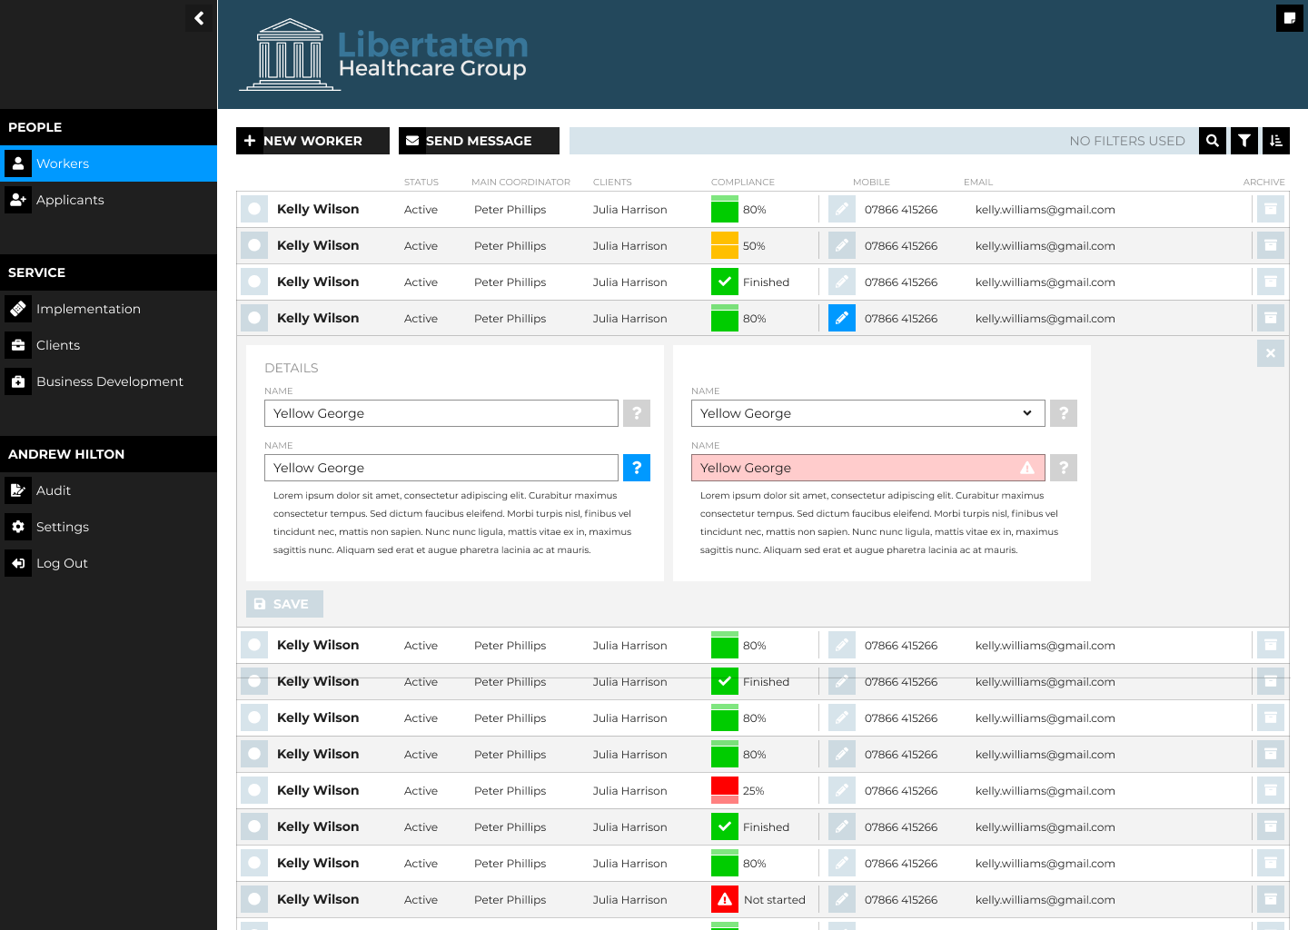
No Pop ups
We can make a better experience for users by getting rid of the pop up windows and building the choices into the work flow.
We can do this because we are not using a generic template solution. We are creating this for Libertatem to solve Libertatem users problems.

Slide 7
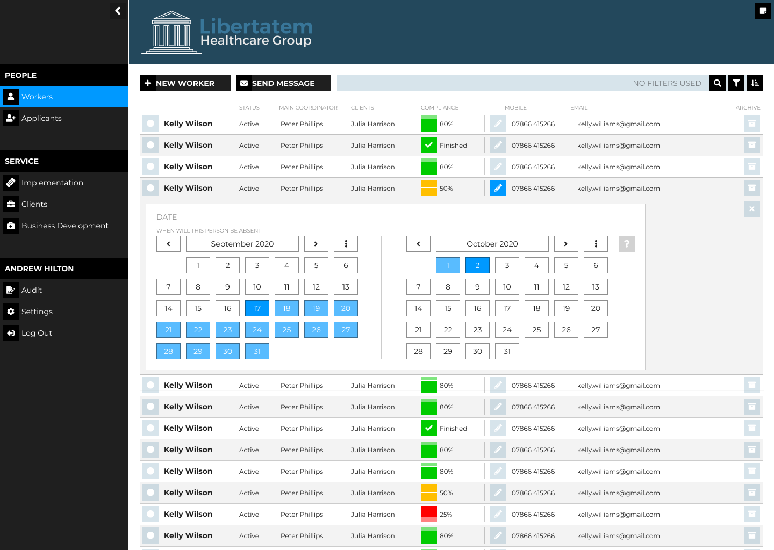
Specific Tools
We can make a Calendar which works just for the problem we are trying to fix.
It might be this....

Slide 8
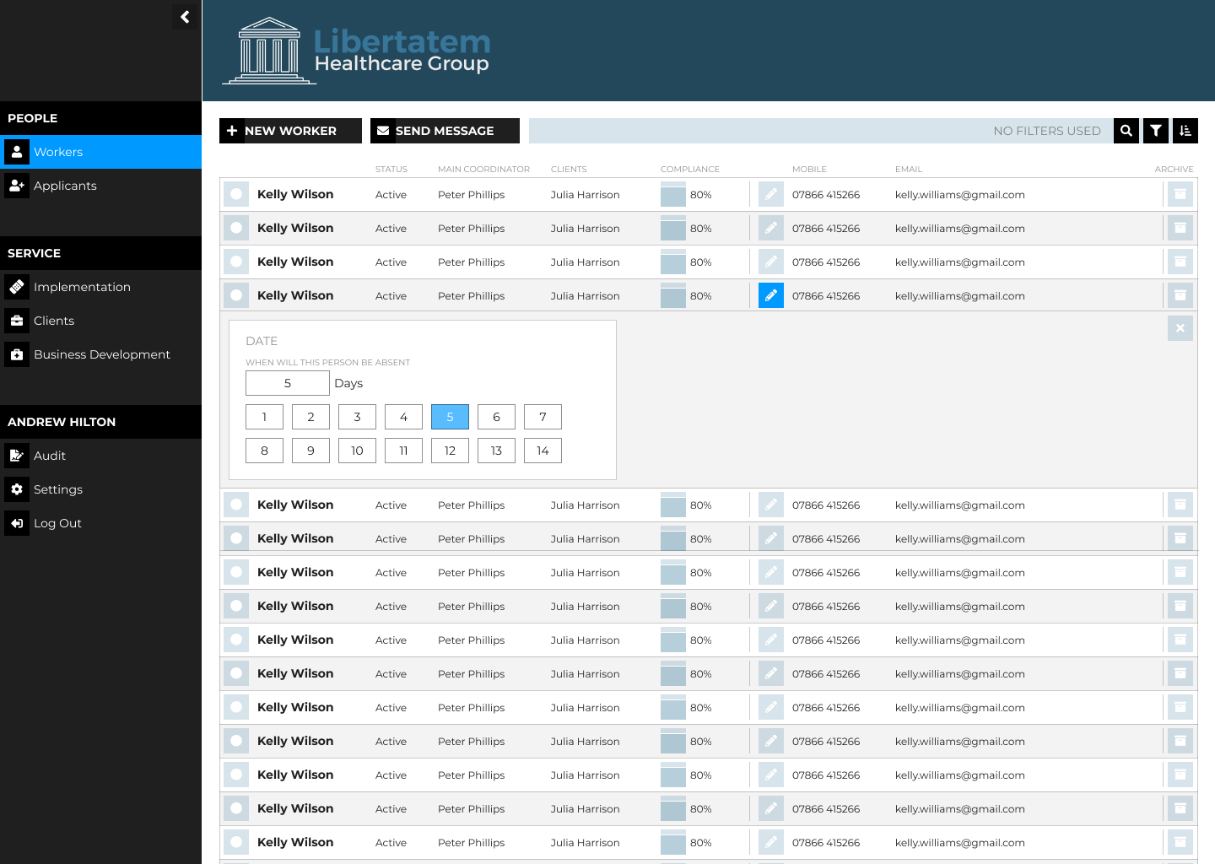
Specific Tools 2
Or we might not want to pick two dates, we might want something that lets us pick a number of days quickly and easily.
Because Andy and I are writing these tools we can make them how we all want them.

Slide 9
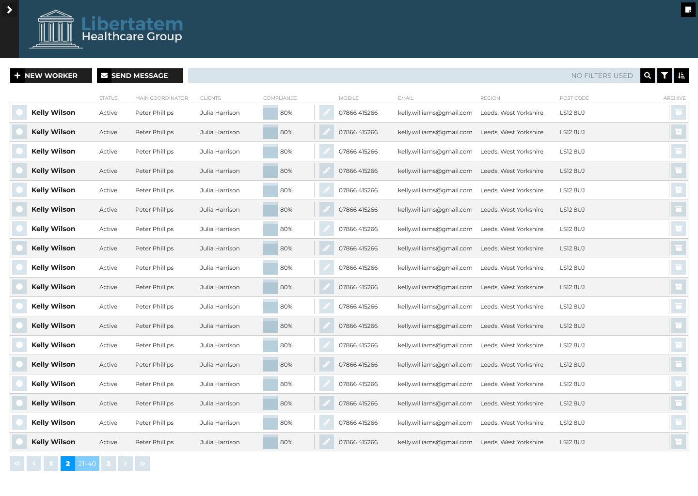
More Space
We are going to use Responsive Design to make sure that we make the best use of the space on people's screens.
That helps make the system future proof.

Slide 10
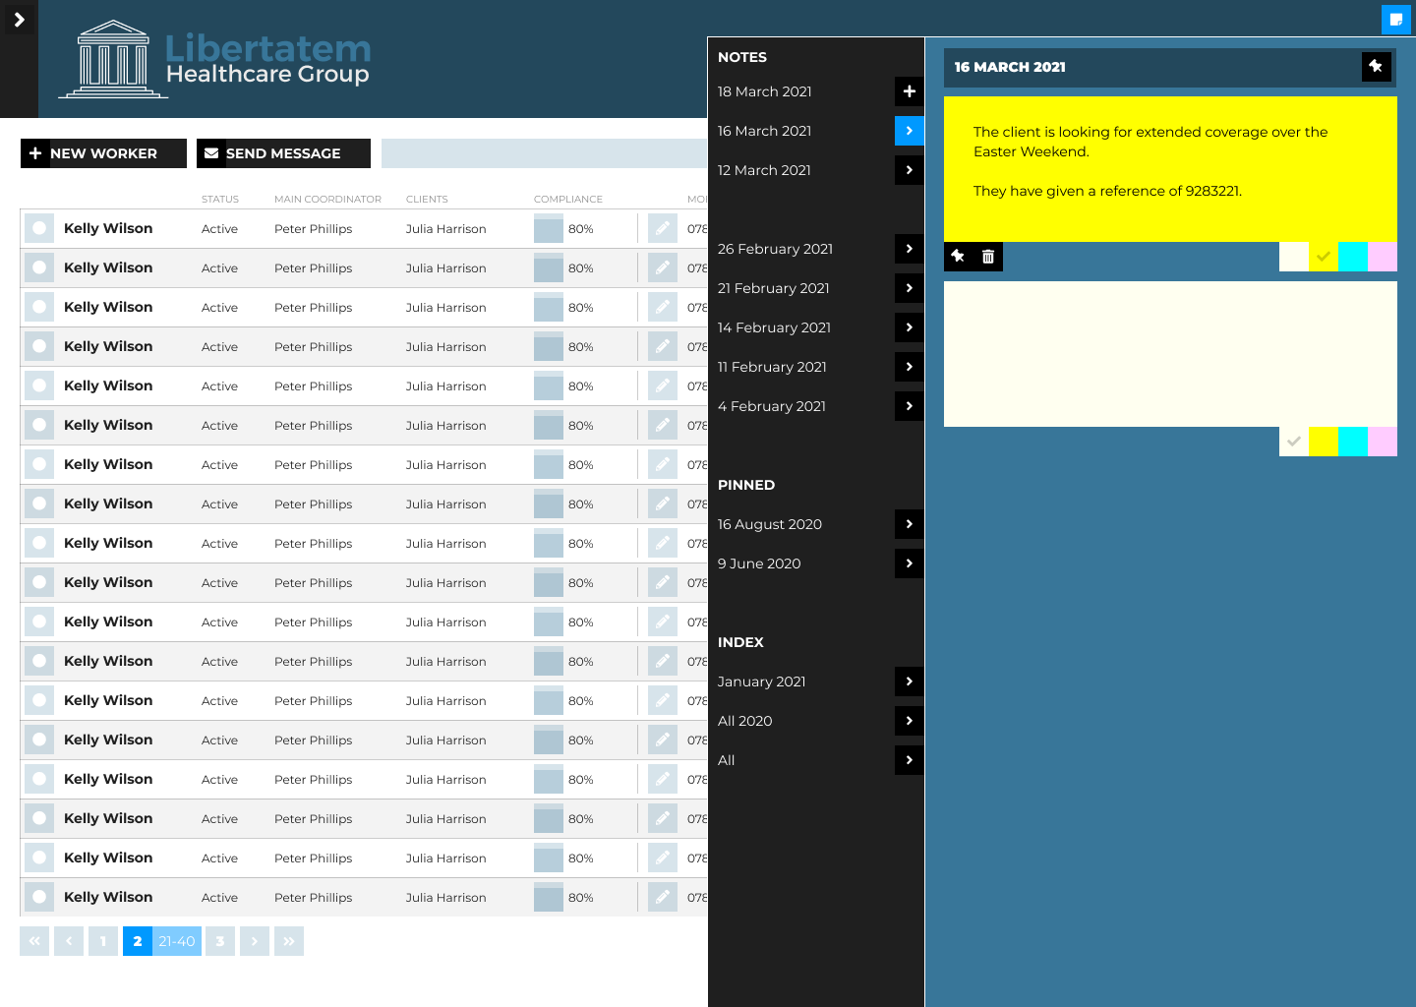
More Tools
We can also start to add some tools to help people who use the system.
This is a Notepad system which would appear on every page that we could add.
It is an idea for the future but once we have a system we can control we can make the Application what we want it to be.

Slide 11
Thank You
First we will have... A duplicate of all the functionality we have now, but with a better interface because we will have made it with you in mind.
Then we could…
Add new tools to capture information better
Add ways of making the application easier to use
Make the website more robust and futureproof

